Slide 1

Problems in genomic vocabularies data

Slide 2
Statistics about number of concepts with different f_type in ClinVar
Variant type | Percentage of variant types | count
complex | 0.0090 | 61
CN gain | 3.7687 | 39399
CN loss | 3.8411 | 39093
deletion | 5.8493 | 75995
duplication | 2.5464 | 33578
fusion | 0.0009 | 6
indel | 0.6278 | 8411
insertion | 0.5402 | 6934
inversion | 0.0484 | 580
NT expansion | 0.0115 | 132
protein sequence only | 0.0152 | 103
short repeat | 1.3546 | 18384
SNP | 81.2587 | 1103107
tandem duplication | 0.0001 | 1
Translocation | 0.0367 | 298
undetermined variant | 0.0914 | 811
Total number of concepts |  | 1326893

Slide 3
Concepts from ClinVar with empty f_name
Variant type | Count
complex | 18
CN gain | 2
CN loss | 1
deletion | 1506
duplication | 661
fusion | 0
indel | 7
insertion | 2
inversion | 6
NT expansion | 2
protein sequence only | 0
short repeat | 0
SNP | 85
tandem duplication | 1
Translocation | 4
undetermined variant | 36

Slide 4
We can not build link to other vocabularies for concepts with empty f_name. So, these concepts should be ignored

Slide 5
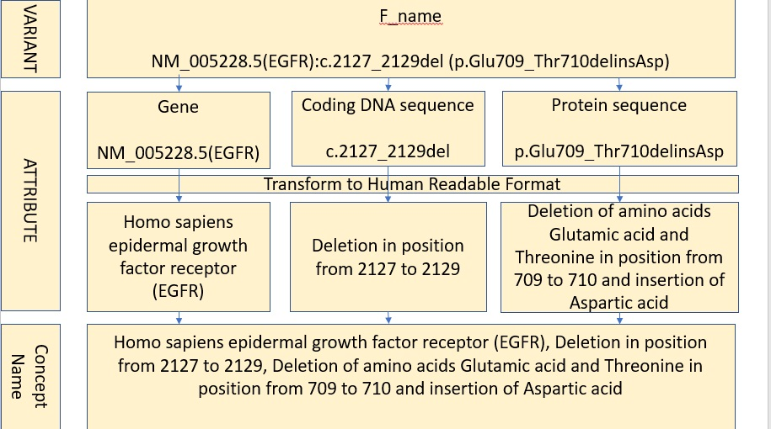

Slide 6

Same chromosome locations, but different HGVS. This case give understanding that we need to identify variants using DNA and protein sequencing if it's possible
alleleid | f_type | f_name | chromosome | f_start | f_stop | alleleid | f_type | f_name | chromosome | f_start | f_stop
29000 | single nucleotide variant | NM_004333.6(BRAF):c.1799T>A (p.Val600Glu) | 7 | 140453136 | 140453136 | 48859 | single nucleotide variant | NM_004333.6(BRAF):c.1799T>G (p.Val600Gly) | 7 | 140453136 | 140453136
29000 | single nucleotide variant | NM_004333.6(BRAF):c.1799T>A (p.Val600Glu) | 7 | 140753336 | 140753336 | 363167 | single nucleotide variant | NM_004333.6(BRAF):c.1799T>C (p.Val600Ala) | 7 | 140753336 | 140753336

Slide 7
Some of hgvs has type 'copy number gain' and 'copy number loss' and these expressions are duplicated because of adding at the different time by the different submitters. 603 distinct of HGVS expressions

Slide 8
Same hgvs expresions(f_name) for different alleleid. E.g. NM_005708.3(GPC6):c.320_711del have two different alleleid and different chromosome location. 40 distinct of HGVS expressions

